Slide 1
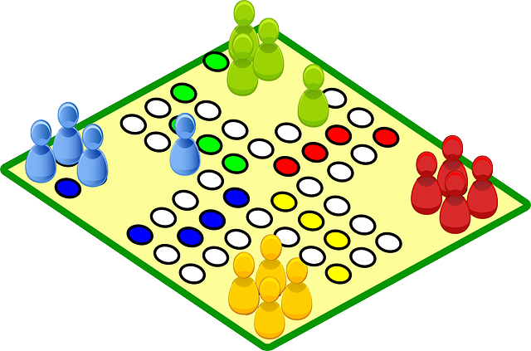
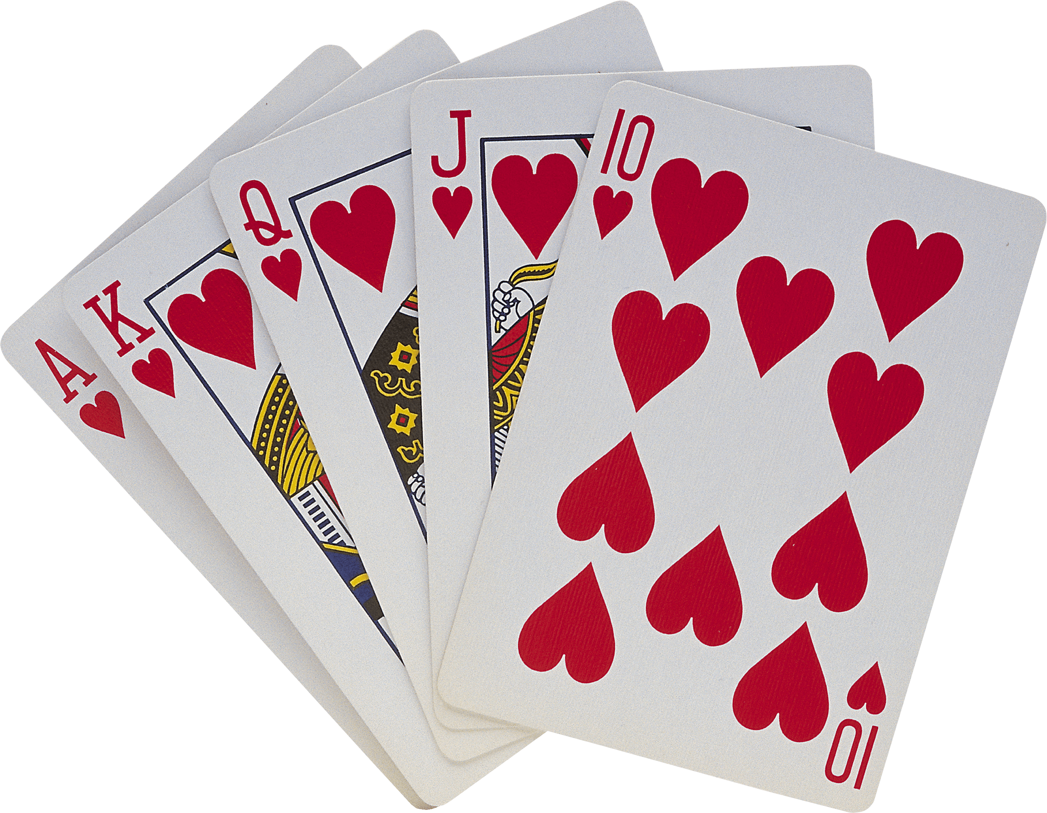
Mrs. Rhodes’
August 14 - 18, 2023
WHAT WE’RE LEARNING
REMINDERS
Read 20 minutes each night and record in reading log
Practice math facts
Math wkst each night
Read Automaticity sheet
Practice word study skills
Review vocabulary words
Please check Pride Binder each night.
READING
Animal Characteristics Unit 1
How do living things survive in their environment?
Paraphrase & retell key ideas
Analyze text using graphic features
Use context clues
Ask questions
Cause & Effect
TEST – August 18
WORD STUDY
Lesson 1: Short Vowels
product listen
contact bread
address helpful
upset
*The words listed are NOT the actual words on the test. This is to practice the pattern for the words using strategies taught in class.
TEST – September 1
GRAMMAR
Multisensory Language Launch
MATH
Topic 1 – Multiplication & Division
SCIENCE/SOCIAL STUDIES
Living and Nonliving Things
IMPORTANT DATES
Aug 18 Habit Team Reveal
Aug 24 Curriculum Night (5:00-6:00)
Sept 4 No School (Labor Day)
Sept 19 Pirate Day (dress like a pirate: school-friendly clothing)
Email: mkrhodes@auburnschools.org
Phone: 334-887-2110

